Slide 1
L6 Group 4 – Pitch 5
Oliver Chamberlain
Daniel Jamieson
Ross Warren
Douglas Simpson

Slide 2
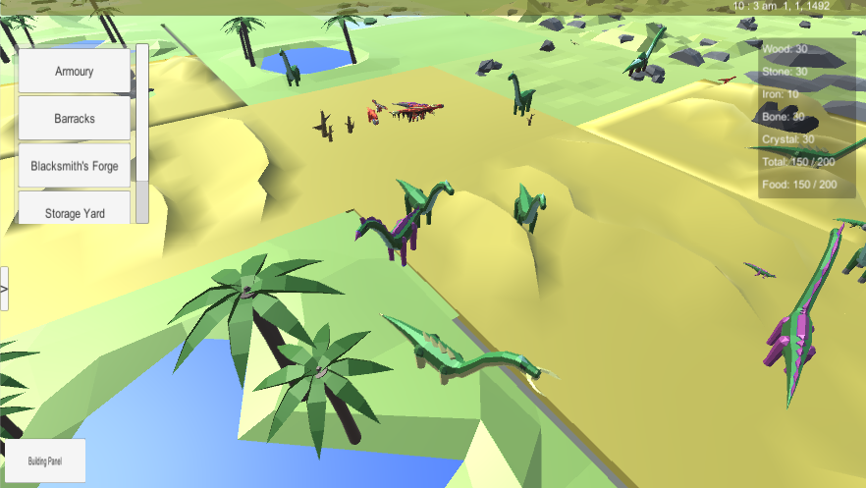
The brief
Game of emergence
Multiple Solutions
Single player
PC

Slide 3
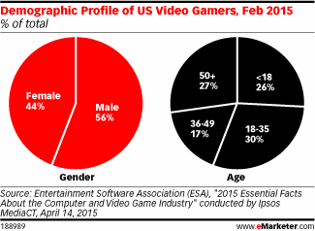
Demographic/Psychographic
Males
Aged 15-25
Students
Management/ City simulation game

Slide 4
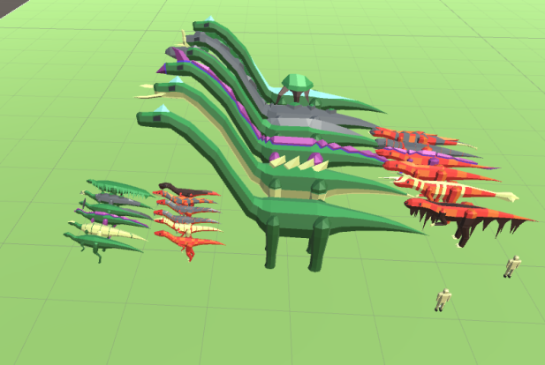
Monster Miner
Colony Simulation
Resource Management
Overhead Camera
Survive and Expand

Slide 5
Colonists
Hunter
Crafter
Gatherer

Slide 6
Main loop
Hunt
Gather
Build/Craft

Slide 7
Buildings
Barracks
Blacksmith
Stockpile/Granary
Armoury
House

Slide 8
Crafting loop
Gather
Craft
Equip

Slide 9
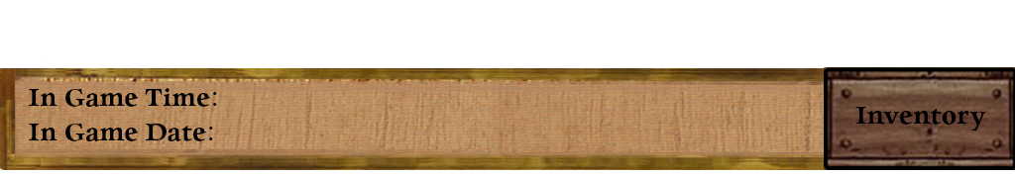
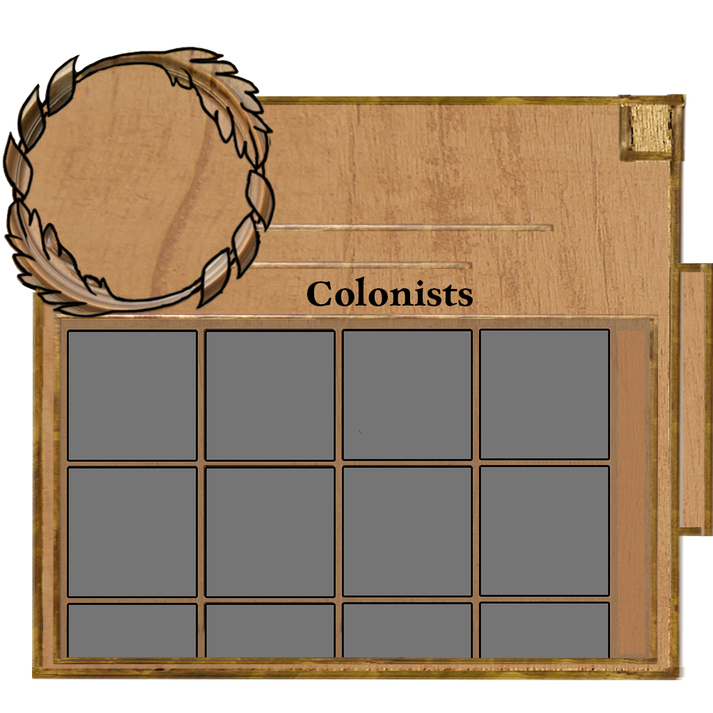
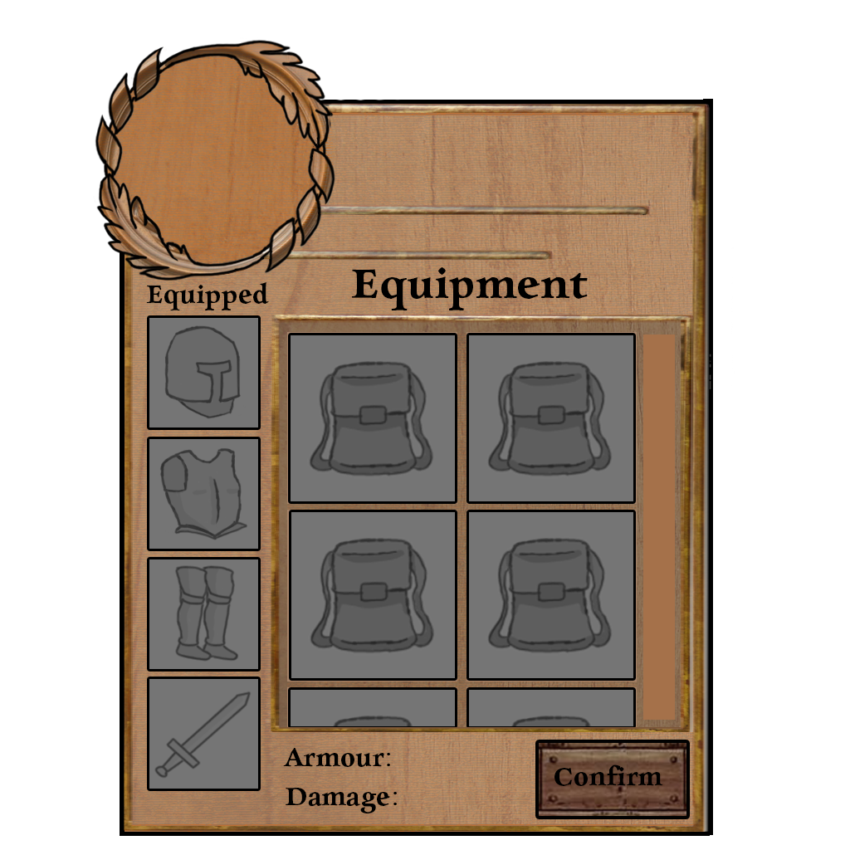
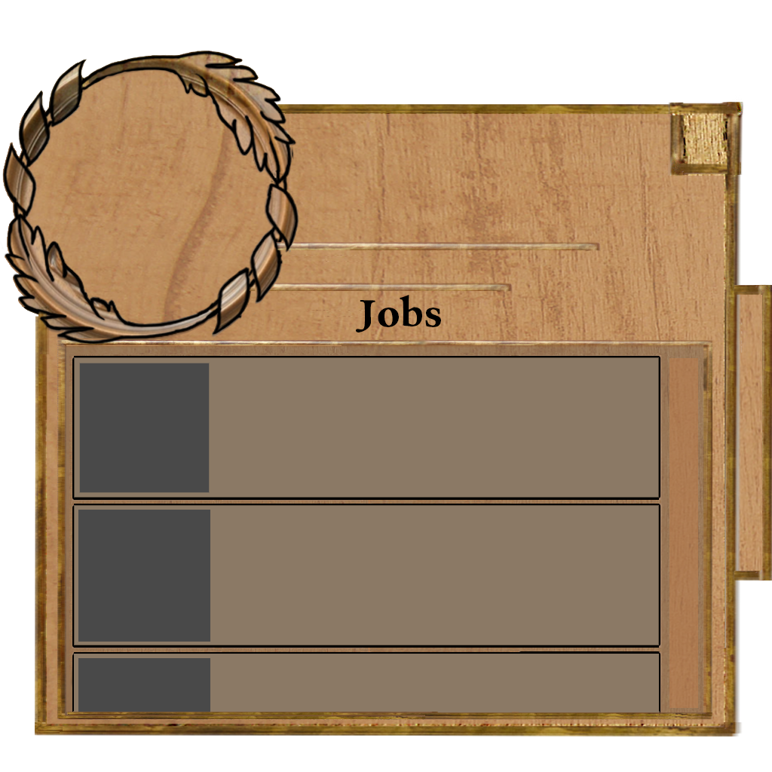
Art Assets (User Interface)

Slide 10
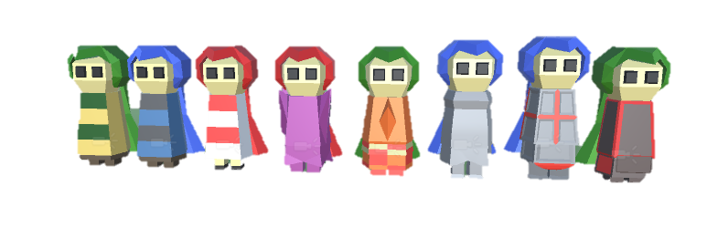
Art Assets (Colonists)

Slide 11
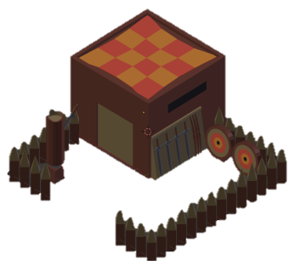
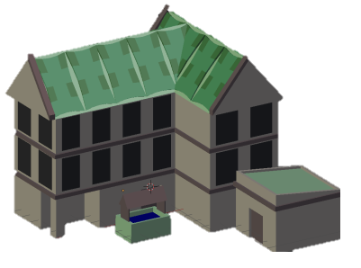
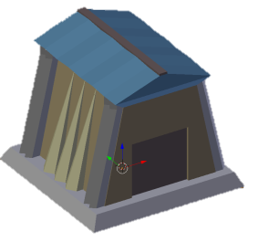
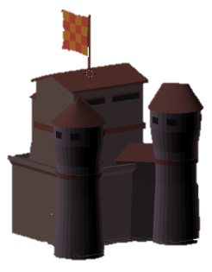
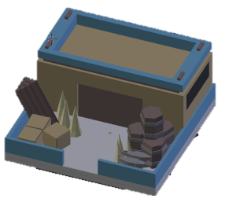
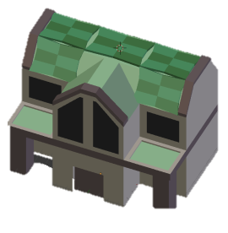
Art Assets (Buildings)

Slide 12
Art Assets (Monsters)

Slide 13
Questions?

